Slide 1
MARKET SINGAPORE®
NEW
PRODUCT LAUNCH

Slide 2
Disclaimer
The products discussed herein are not intended to diagnose, treat, cure or prevent any disease.

Slide 3
Your Concerns?
Not sleeping well

Slide 4
Your Concerns?
BETTER SUPPORT YOUR
BONE HEALTH

Slide 5
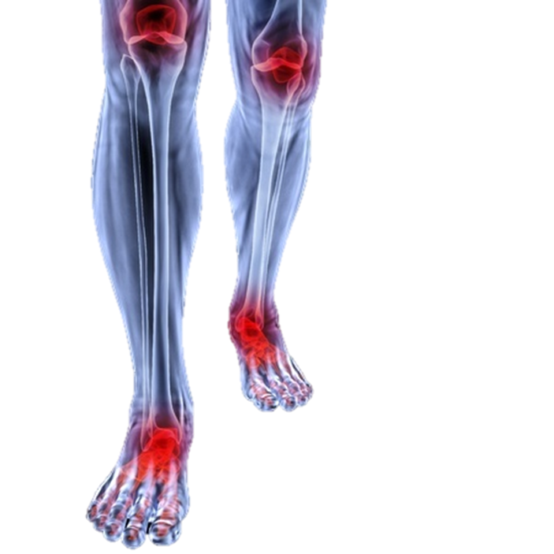
Your Concerns?
MUSCLE DISCOMFORT

Slide 6
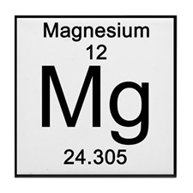
Functions of Magnesium
Helps maintain normal levels of potassium, phosphorus and calcium
Supports normal function of muscle and nervous tissue
Helps maintain normal
regulation of heart and blood pressure

Slide 7
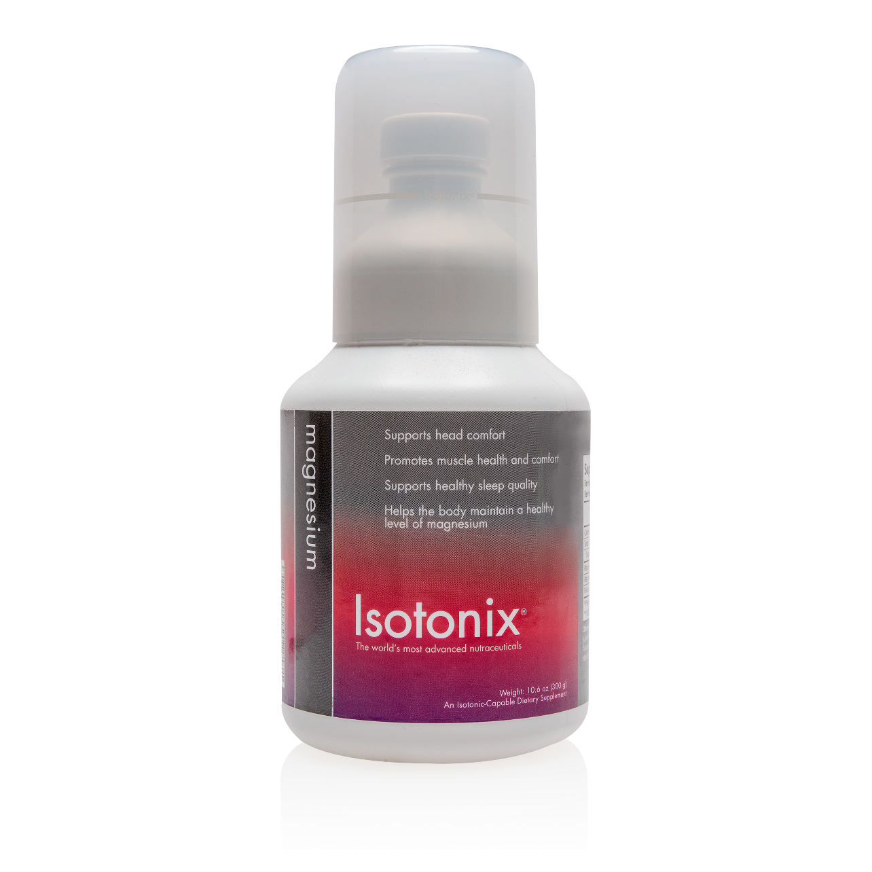
Introducing Isotonix® Magnesium
Available
Now
Code: SG12989 | DC:S$46.25 | SR:S$64.75 | BV:20
MAHP1700403

Slide 8
Benefits of Isotonix® Magnesium
Supports sleep quality
Supports bone health
Supports muscle health and comfort
Helps the body maintain healthy
magnesium levels
Code: SG12989 | DC:S$46.25 | SR:S$64.75 | BV:20
MAHP1700403

Slide 9
Give The Best To Your Children

Slide 10
Your Children’s Digestive Tract is Delicate…
Both healthy bacteria (probiotics) and potentially unhealthy bacteria populate within the digestive tract.
Maintaining a balance of these two types of bacteria is essential in maintaining health.

Slide 11
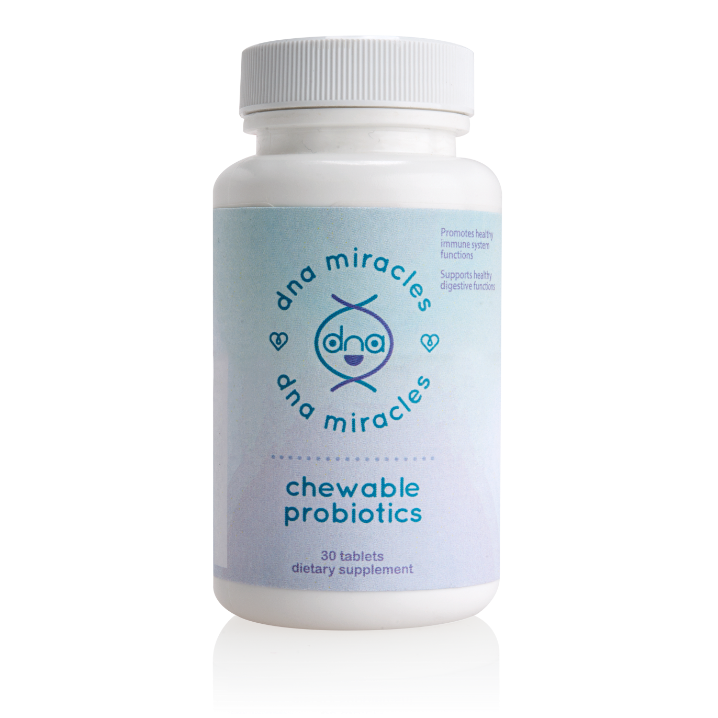
DNA Miracles™ Chewable Probiotics
FOR YOUR KIDS
AVAILABLE NOW
Code: SG6940 | DC:S$38.75 | SR:S$54.25 | BV:17

Slide 12
DNA Miracles™ Chewable Probiotics
Delivers five billion bacteria in each chewable tablet
Utilises the LiveBac™* tableting process to ensure viability of the bacteria
Promotes healthy immune system functions
*LiveBac™ is the trademark of Nutraceutix Inc.
Code: SG6940 | DC:S$38.75 | SR:S$54.25 | BV:17

Slide 13
DNA Miracles™ Chewable Probiotics
Provides good bacteria to help maintain bacterial
balance
Provides beneficial bacteria to promote healthy
digestion
Promotes stomach comfort and bowel regularity
Code: SG6940 | DC:S$38.75 | SR:S$54.25 | BV:17

Slide 14
DNA Miracles™ Chewable Probiotics
Supports healthy digestive functions
Supports healthy teeth and gums
Contains five unique bacterial strains
◦Streptococcus salivarius
◦Lactobacillus rhamnosus
◦Lactobacillus salivarius
◦Lactobacillus paracasei
◦Lactobacillus plantarum
Code: SG6940 | DC:S$38.75 | SR:S$54.25 | BV:17

Slide 15
Start enhancing
Your
Driving experience

Slide 16
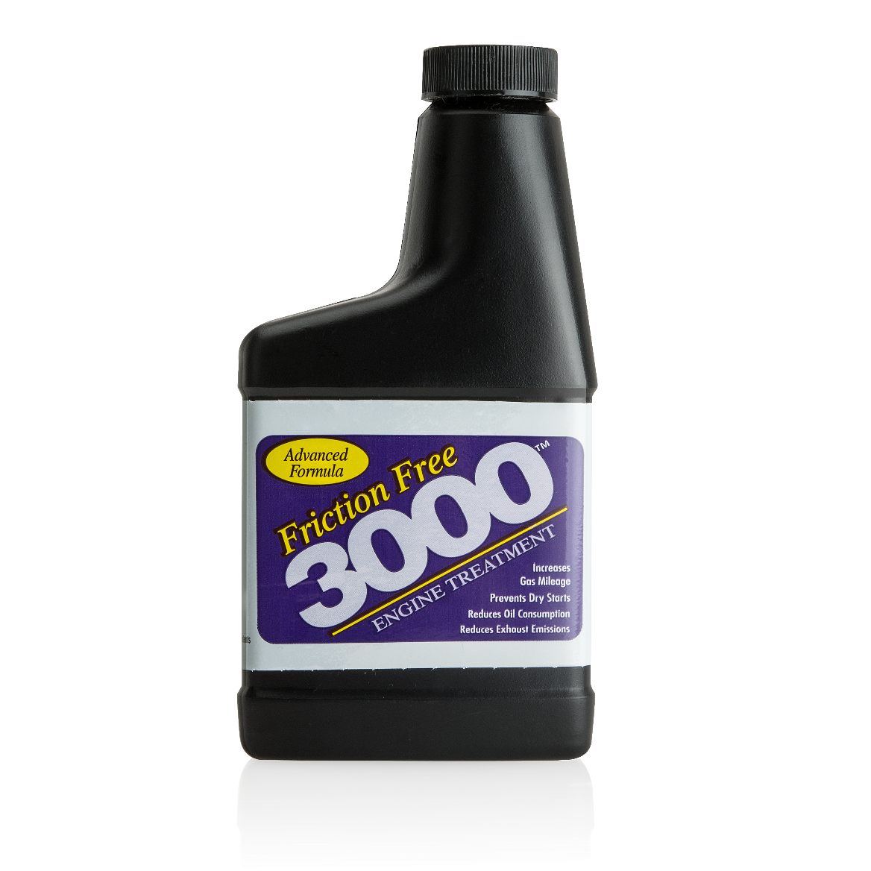
Friction Free 3000™ Engine Treatment
Introducing
Available
Now
Better Engine Performance
And Better For The Environment
Notes:
16
Introduction

Slide 17
Friction Free 3000™ Engine Treatment
How is it different
from other engine additives on the market ?
A unique engine oil additive designed to enhance the performance of your existing engine oil.
The resulting benefits include improved engine performance, extended engine life, and reduced carbon emissions.
Code: SG6530 | DC:S$25.50 | SR:S$35.75 | BV: 8.5
Notes:
17
Introduction

Slide 18
Friction Free 3000™ Engine Treatment
What benefits can we expect?
Increases gas mileage
Better engine performance
Normal compression
Prevents dry starts
Decreases engine wear
Reduces oil consumption
Increases engine life
Code: SG6530 | DC:S$25.50 | SR:S$35.75 | BV: 8.5
Notes:
18
Introduction

Slide 19
STAY IN TOUCH WITH US
ISOTONIXMASG
Products Available on SG.SHOP.COM and SG.ISOTONIX.COM

